Slide 1
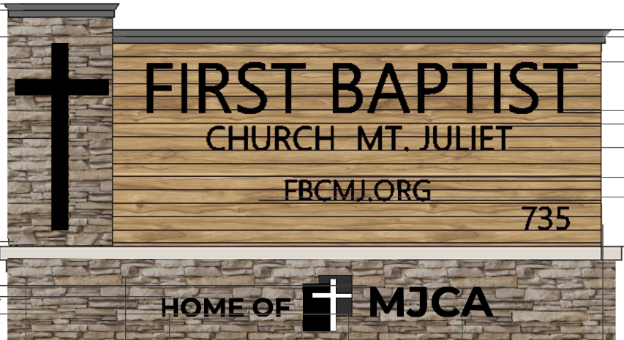
Insert New Church Sign Photo
First Baptist Church Mount Juliet
Campus Update Meeting
June 28, 2020

Slide 2
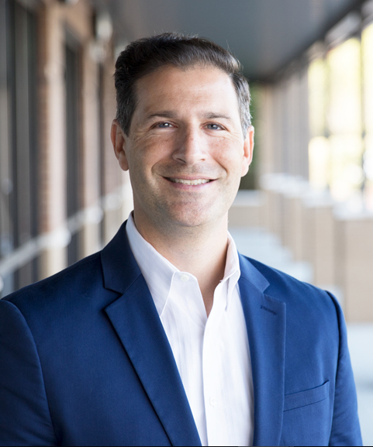
Introduction from Pastor Phillip

Slide 3
Agenda for Today’s Discussion
Pastor Phillip Welcome
Insurance Assessment Update
MJCA Update
Campus Planning Team Update
A Peek At Our Future Campus
Church Finances and Fund Raising
Next Steps
Q&A

Slide 4
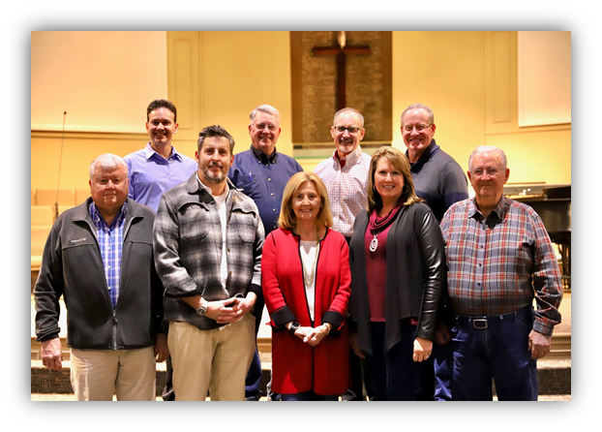
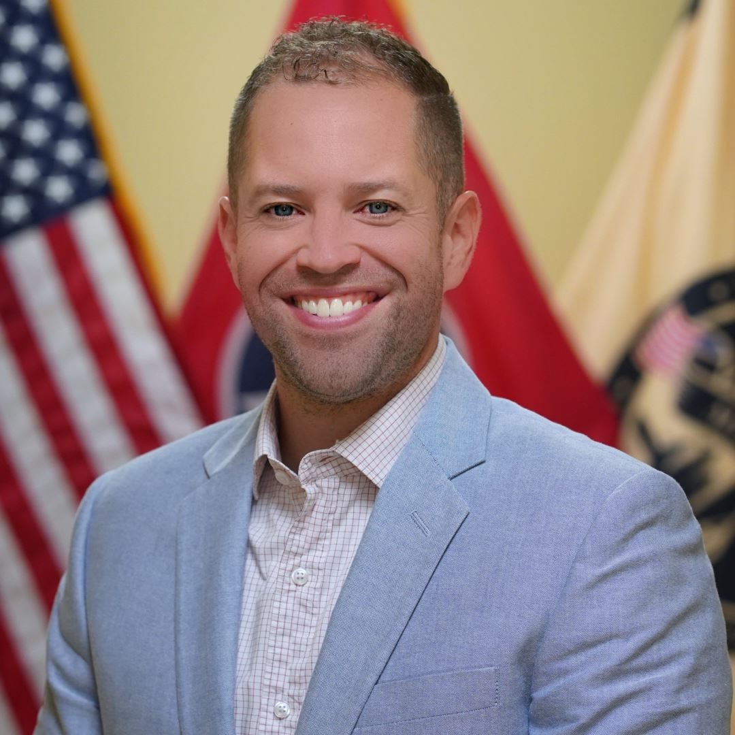
Campus Planning Team Update - Rich Ormsby, CPT Chair

Slide 5
Insurance Update
Initial estimate has been received from Selective Insurance Company – ($4.2 Million)
Our Project Manager and our Private Adjuster are currently working through the estimate. Once completed, they will respond to our insurance company
FEMA funds available will not be determined until the insurance claim has been finalized
Pending a final settlement, repairs to existing facilities are expected to begin in September, 2020, and targeted to be completed in the Fall of 2021.

Slide 6
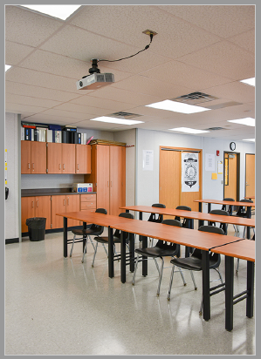
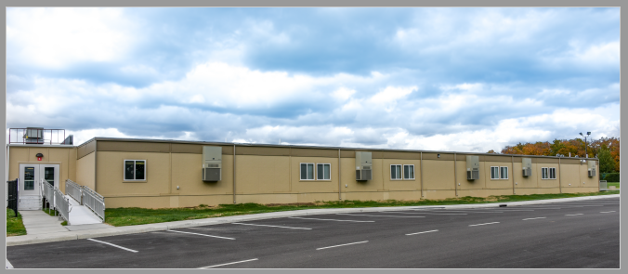
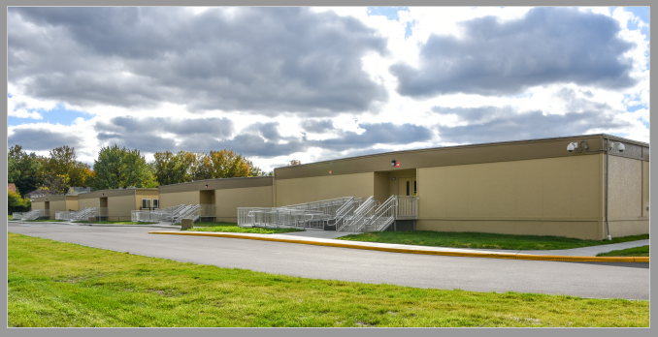
MJCA Update

Slide 7
Our Future Campus

Slide 8
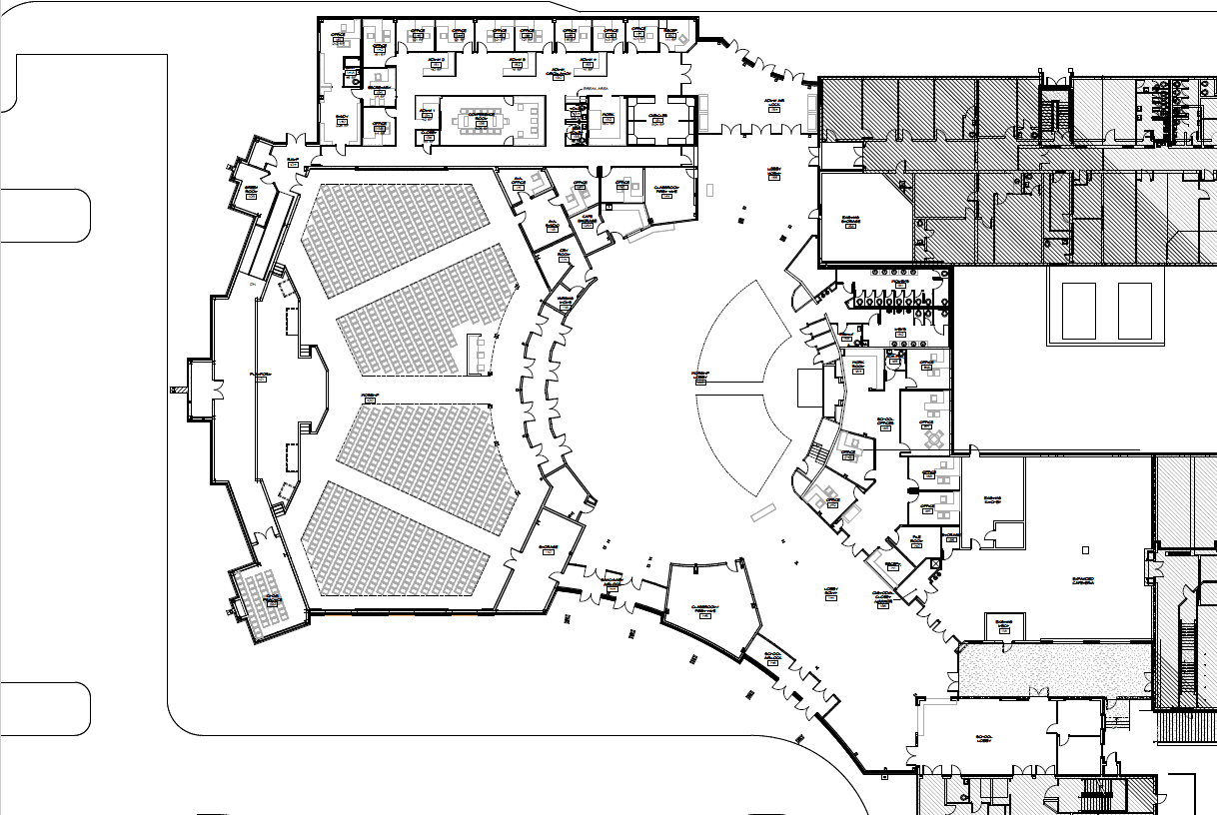
Preliminary Drawings: New Worship Center and Facility Upgrades Floorplan

Slide 9
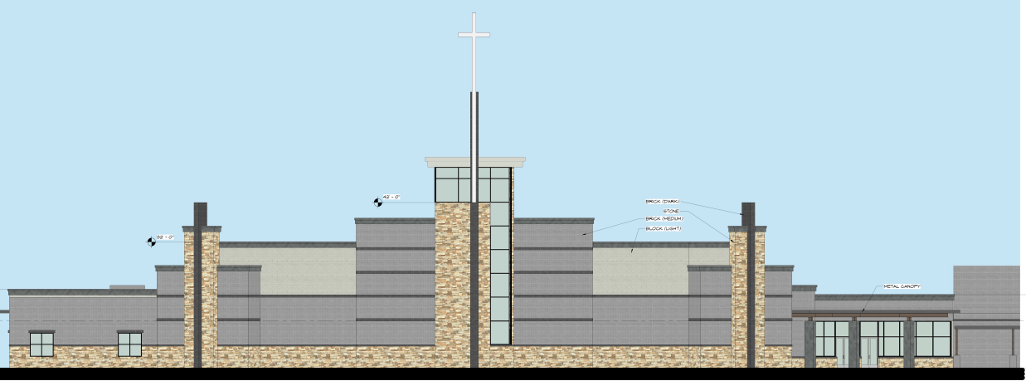
Preliminary Drawings: New Worship Center Street View

Slide 10
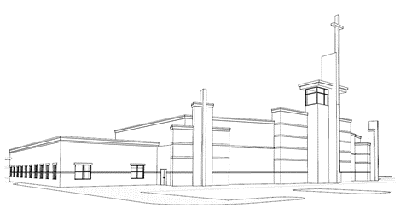
Preliminary Drawings: New Worship Center Street View 3D

Slide 11
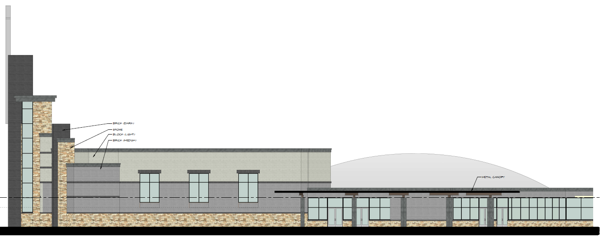
Preliminary Drawings: New Worship Center South Facing View

Slide 12
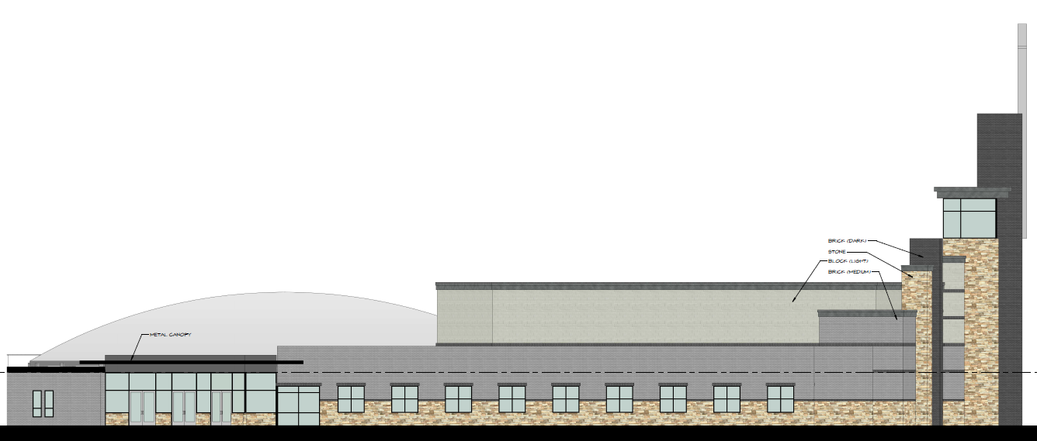
Preliminary Drawings: New Worship Center North Facing View
INSERT IMAGE HERE

Slide 13
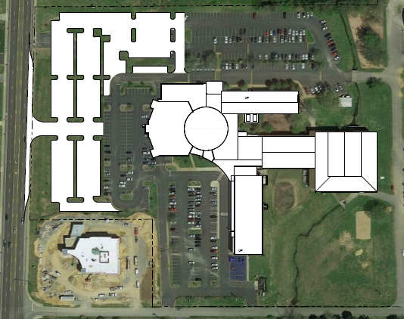
Preliminary Drawings: Campus Layout (Overhead View)
Site Plan Photo

Slide 14
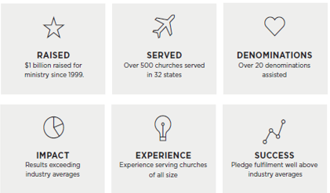
Exploring Professional Services – Capital Campaign & Financial Services
A Christian Lending Firm

Slide 15
Next Steps and Target Dates
Complete full expansion project cost budget
Present Campus Expansion Costs and other specifics for church approval - end of July / early August
Complete settlement discussions with insurance and accept funds - July
Campus expansion groundbreaking – Fall, 2020
Target completion date for campus expansion and rebuild – Fall, 2021

Slide 16
Q&A
Additional questions can be sent to info@fbcmj.org

Slide 17
Final Thoughts from Pastor Phillip

